Slide 1




Everything blue is a guide. Delete it before you download.
Notes:
Slide 1. Hook. Swap in a photo of the common mistake in both glass panes (use the same photo twice).

Slide 2


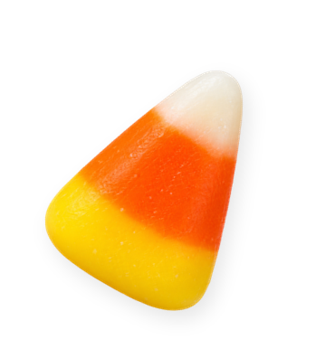
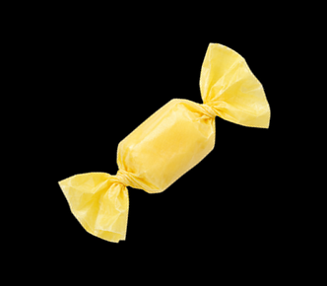
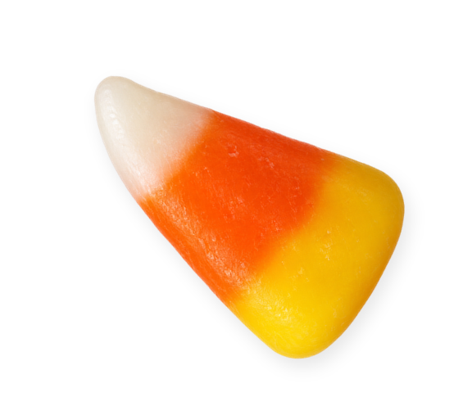
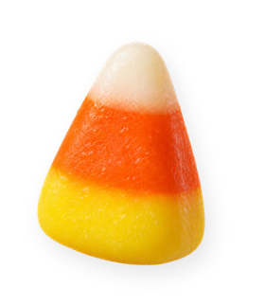
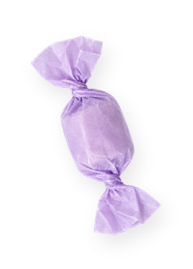
[something sweet
is coming]
[trick first]
Notes:
Slide 2. Second hook: Instagram often shows a carousel starting on slide 2, so this one works as a cover on its own. Swap in a photo of your product for the open doorway. Edit both [bracket] lines.

Slide 3


the trick:
[cheap
sponges]
Notes:
Slide 3. The trick: a photo of the common mistake. Name it on the note.

Slide 4



[our 5-minute scrub]
Notes:
Slide 4. The treat: swap in your product photo and say what it is.

Slide 5

the proof:
[5-star
reviews]
Notes:
Slide 5. The proof: a photo of the result or a happy customer. Edit the note.

Slide 6


[TREAT]
[for something sweet: 15% off]
Notes:
Slide 6. Type your keyword and your offer. Caption to start from (CTA in the first two sentences, 3 hashtags): Comment [KEYWORD] and I will send you [the link]. [One line of real context: who it helps or how you use it.] #[tag] #[tag] #[tag]

